Slide 1
SAS Interview Presentation
Maurice M. Materise

Slide 2
Agenda
Prompt
Tools
Initial Assumptions
Solution
Test Cases
Example Results
User Interface
Challenges
Questions
Thanks

Slide 3
Prompt
A customer is asking for a script / program they can give out to their HR department to help speed up business operations. You have been given the following acceptance criteria:
Given I have an array of employee records that include their birthday
When I execute this script/program with the array of employees
Then I am returned an array of employees who's birthday is in the current month
Guidelines:
Build a runnable script/program that meets the above acceptance criteria
Use the language and development tools of your choice
The interface with this script or program is up to you
Should be tested

Slide 4
Tools
Github
Python
Flask
Javascript
JQuery
Bootstrap

Slide 5
Initial Assumptions
Data Format
Use Case
The data is in a JSON format with key value pairs for employee details.
The object is simply to view which employees have birthdays in a select month. HR would want results in a UI, not from a command line result.
Data is Valid
The data is in valid format. Error checks on the data received not included. I would expect the error checking to occur on data input.

Slide 6
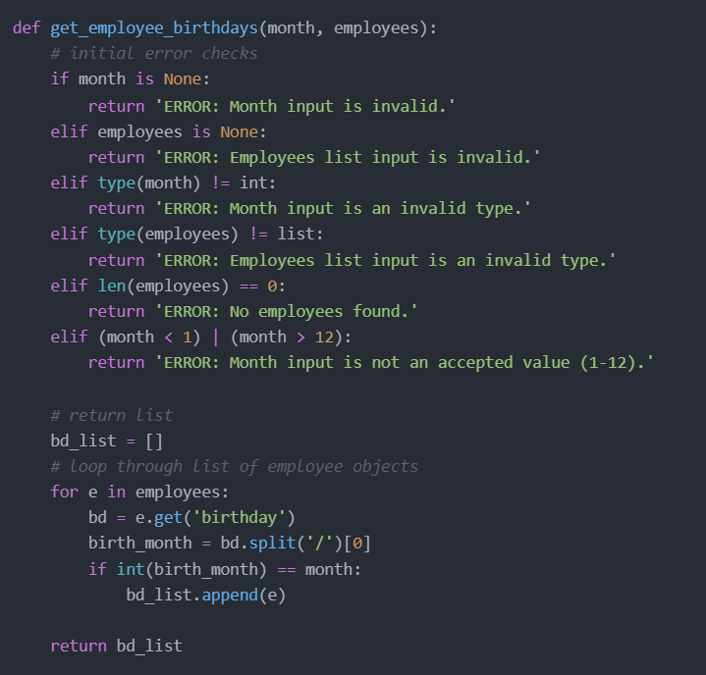
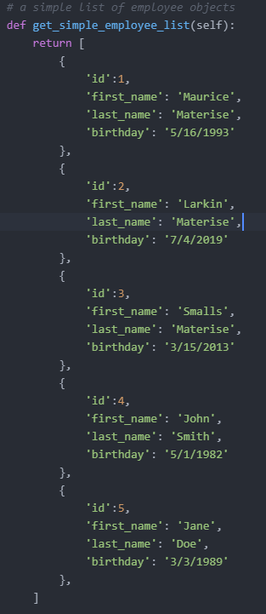
Solution
Example data:
Code: https://github.com/materimm/SAS/blob/main/employees.py

Slide 7
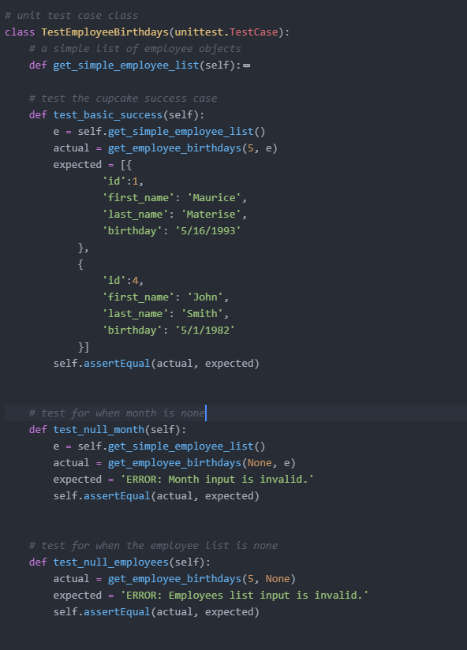
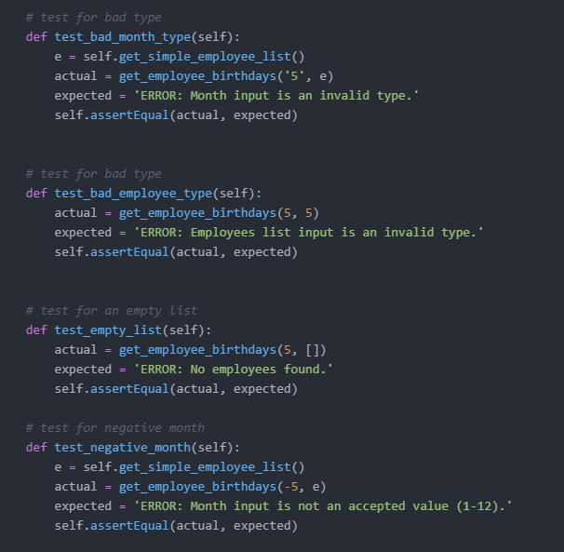
Test Cases
Basic success
Null month
Null employee list
Bad month type
Bad employee type
Empty employee list
Negative month value
Test case library: unittest

Slide 8
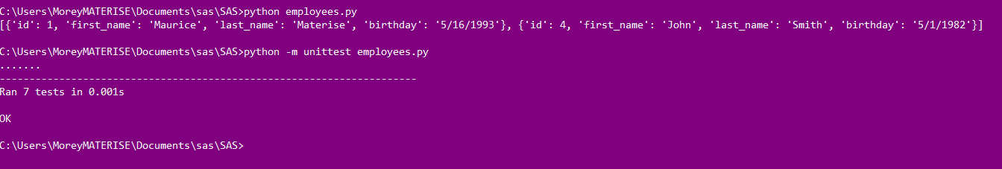
Example Results

Slide 9
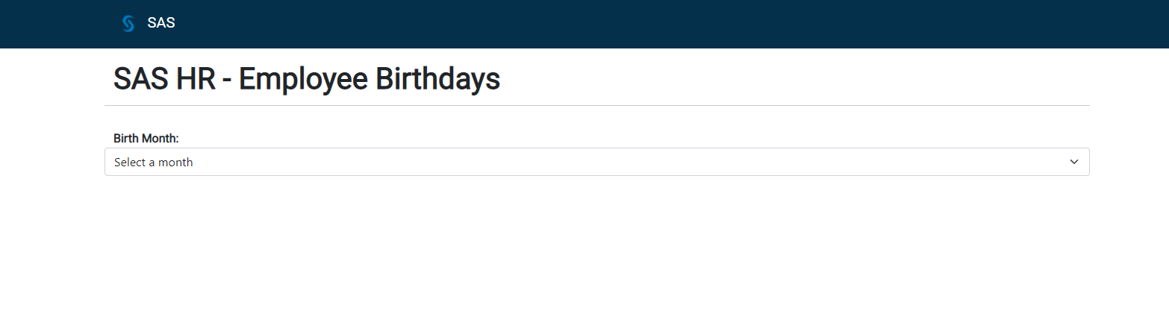
User Interface

Slide 10
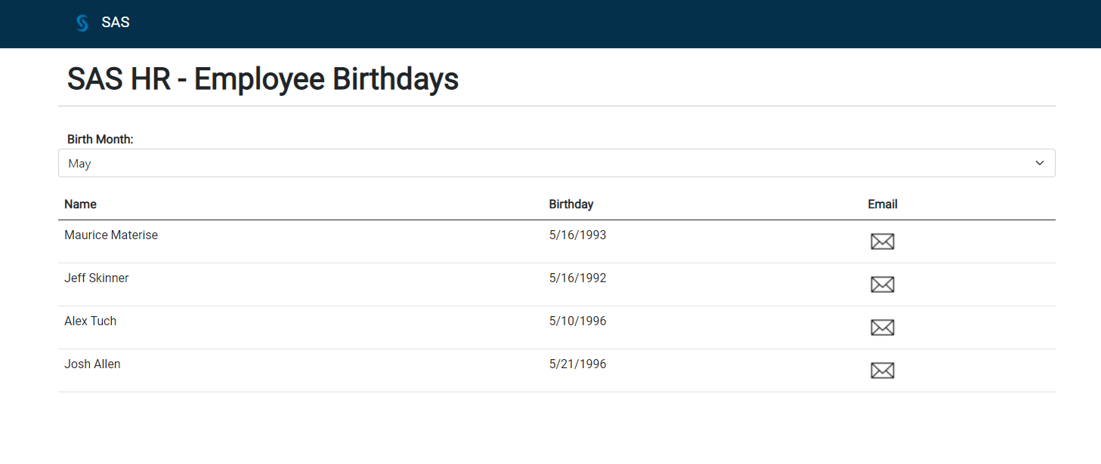
User Interface

Slide 11
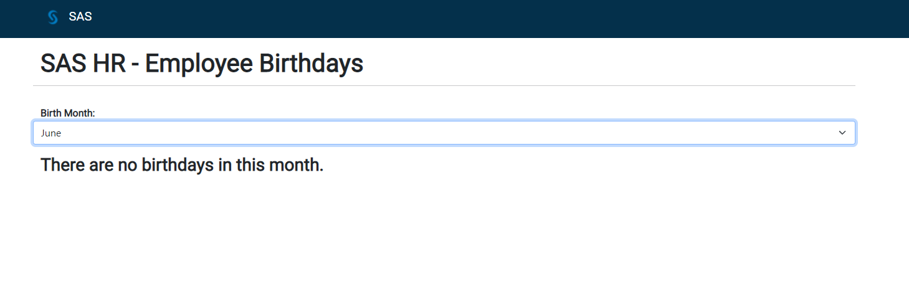
User Interface

Slide 12
Challenges
User Problem
Use Case
Data
Errors to check
What is the problem to solve?
What is the use case for the solution?
Lack of stakeholder feedback
Where is the data?
Data format
Personal Information access
Bad keys, wrong birthday format
Database injection from UI

Slide 13
Questions

Slide 14
THANK YOU
Maurice M. Materise
716-796-5849
mmaterise@gmail.com
Full Code Base: https://github.com/materimm/SAS
LinkedIn: https://www.linkedin.com/in/maurice-materise-72301575/

